Slide 1

Integration of Data Catalog with Content Search Technologies
Sprint 3 Final Update
March 27, 2023
Team Mindbots

Slide 2
Agenda
Youtrack Slide
Results from Sprint 3

Slide 3
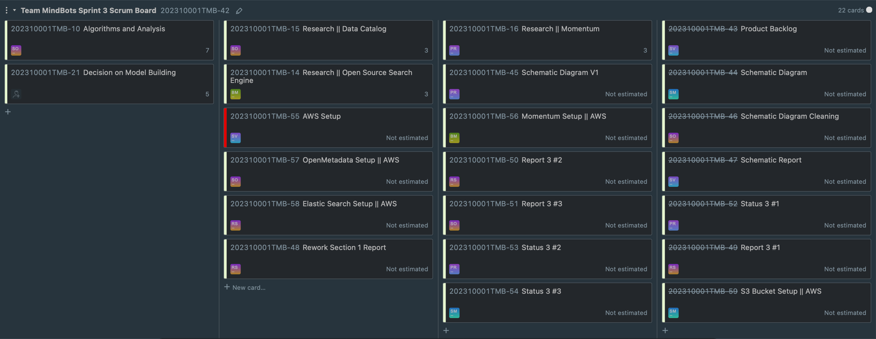
Youtrack Slides
Major areas of Focus in Sprint 3
Setup of Required Tools like Open Metadata, Elastic Search, AWS
Schematic diagram and improvements
Report

Slide 4

Results from Sprint 3
Let’s dive in

Slide 5
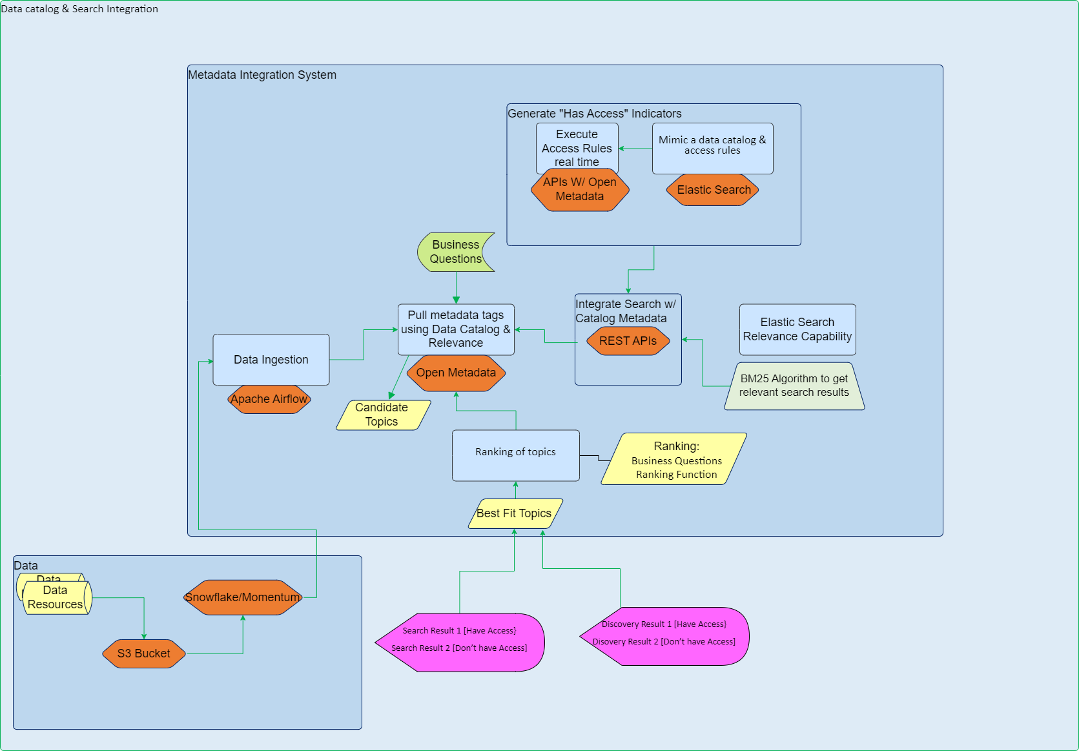
Schematic Diagram

Slide 6
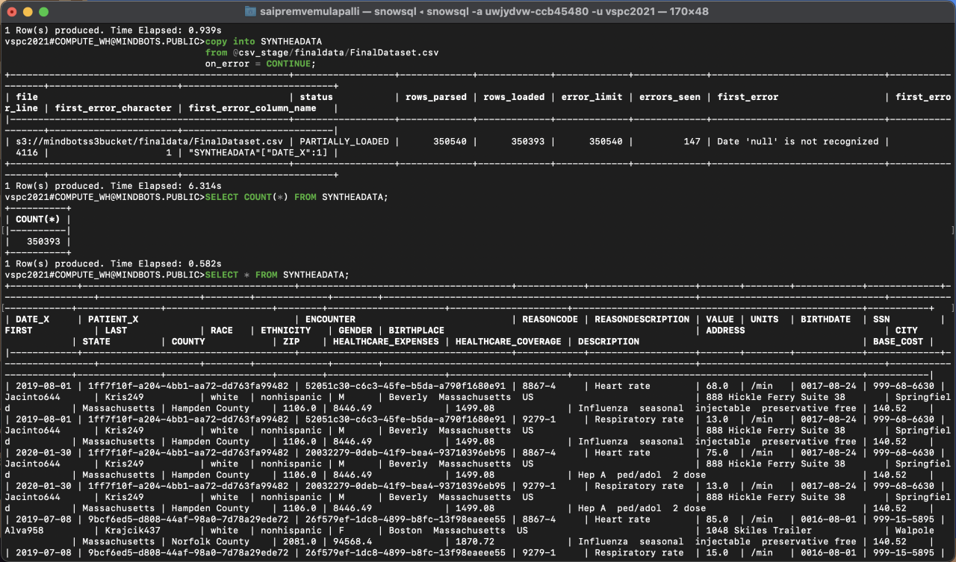
Data Ingestion to Open Metadata

Slide 7
AWS Setup
Currently working on AWS setup with Prof. Ansari and Dan to resolve AWS connectivity issues

